Slide 1
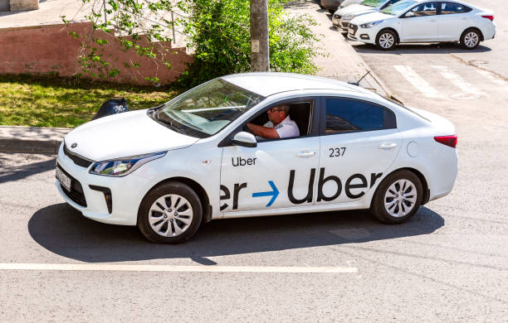
🚗 Uber Ride Analytics Dataset 2024

Slide 2
About The Dataset
This comprehensive dataset contains detailed ride-sharing data from Uber operations for the year 2024, providing rich insights into:
Booking patterns
vehicle performance
revenue streams
cancellation behaviors
customer satisfaction metrics.

Slide 3

Key Statistics: Total Bookings: 148.77K rides Success Rate: 65.96% (93K completed rides) Cancellation Rate: 25% (37.43K cancelled bookings) Customer Cancellations: 19.15% (27K rides) Driver Cancellations: 7.45% (10.5K rides)

Slide 4

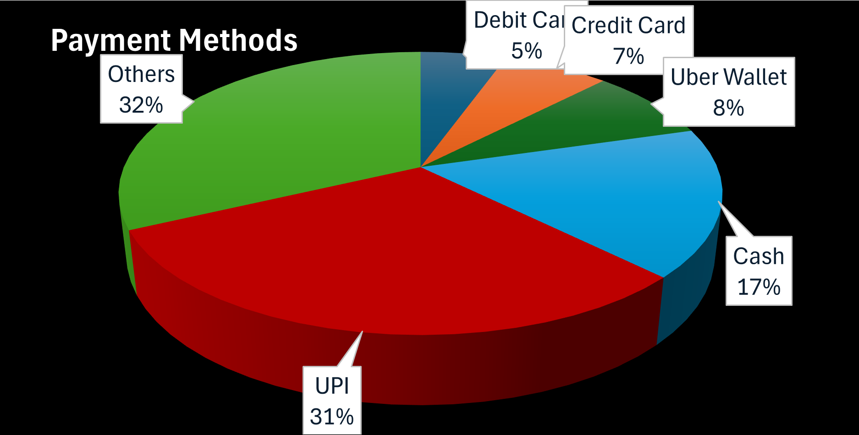
Revenue Distribution by Payment Method UPI: Highest contributor (~40% of total revenue) Cash: Second highest (~25% of total revenue) Credit Card: ~15% of total revenue Uber Wallet: ~12% of total revenue Debit Card: ~8% of total revenue

Slide 5
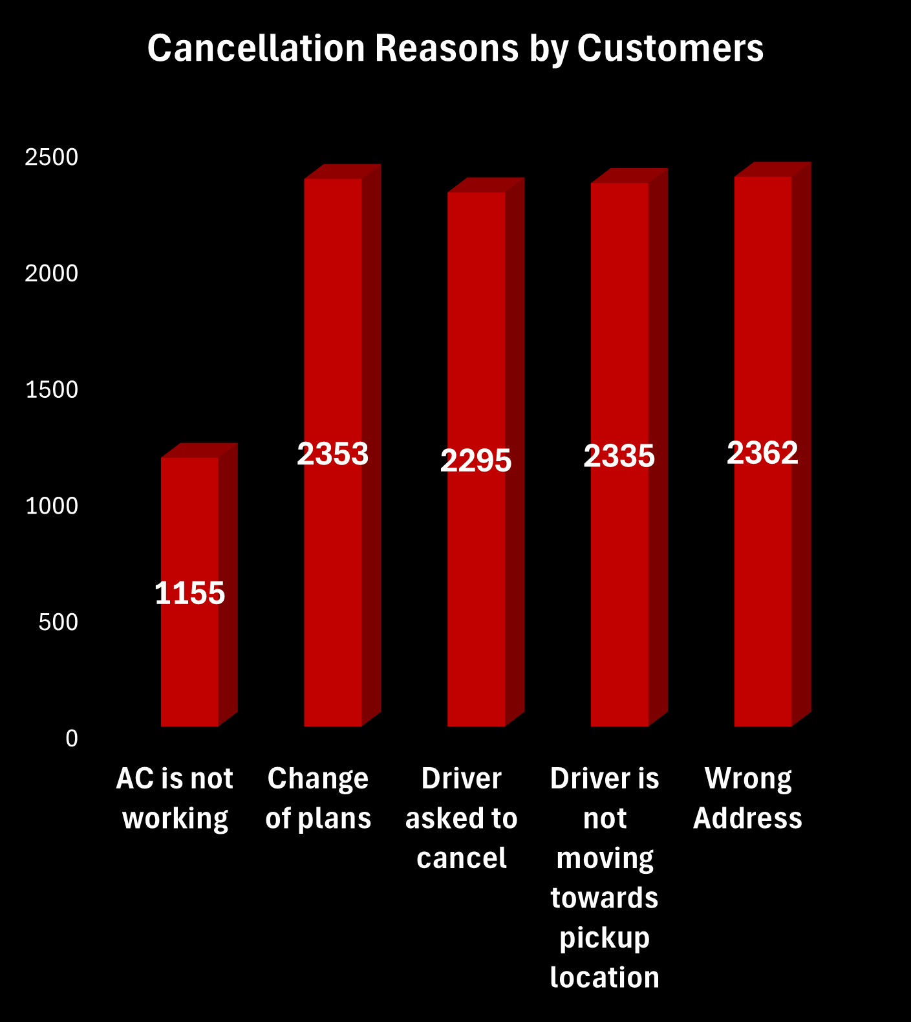
🚫 Cancellation Patterns Customer Cancellation Reasons:
Customer Cancellation Reasons:
Wrong Address: 22.5%
Driver Issues: 22.4%
Driver Not Moving: 22.2%
Change of Plans: 21.9%
App Issues: 11.0%

Slide 6
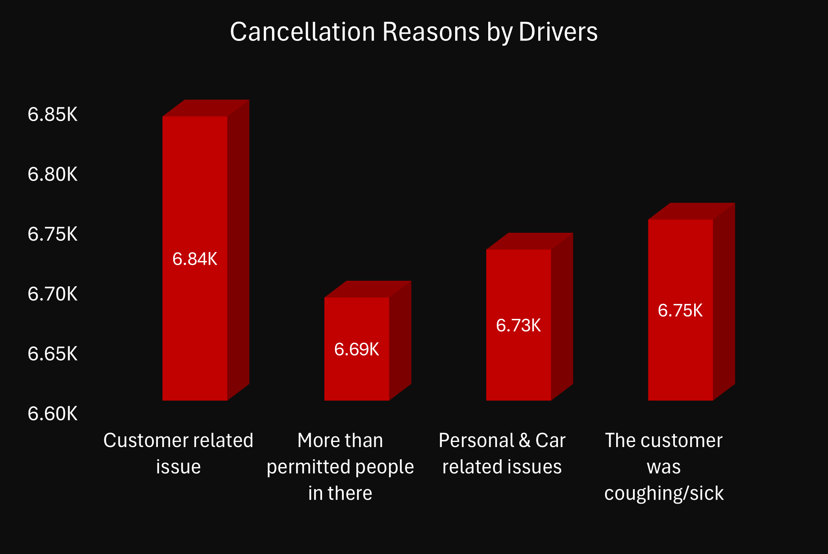
Driver Cancellation Reasons:
Capacity Issues: 25.0%
Customer Related Issues: 25.3%
Personal & Car Issues: 24.9%
Customer Behavior: 24.8%

Slide 7

⭐ Rating Analysis
Customer Ratings: Consistently high across all vehicle types (4.40-4.41)
Driver Ratings: Slightly lower but stable (4.23-4.24)
Highest Rated: Go Sedan (4.41 customer rating)
Most Satisfied Drivers: UberXL category (4.24 rating)

Slide 8

📈 Data Quality
Completeness: Comprehensive coverage with minimal missing values
Consistency: Standardized vehicle types and status categories
Temporal Coverage: Full year 2024 data with daily granularity
Geographic Scope: Multiple pickup and drop locations
Balanced Distribution: Good representation across all vehicle types and time periods.

Slide 9

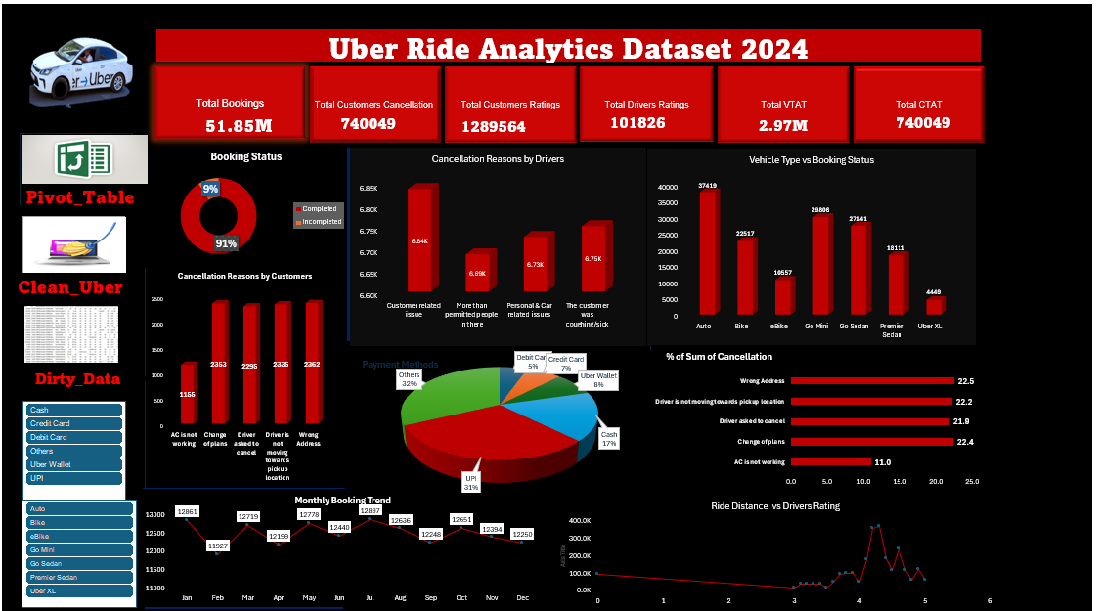
Dashboard​

Slide 10

THANK YOU

